Slide 1
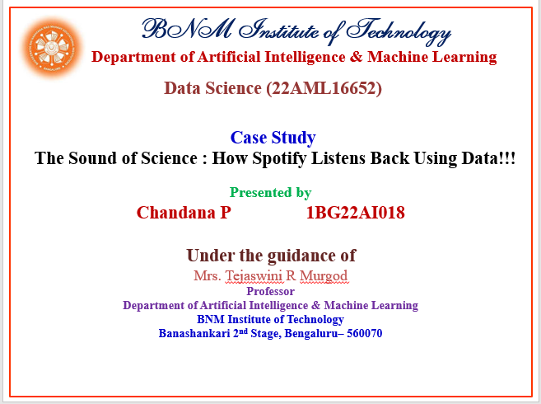

Slide 2

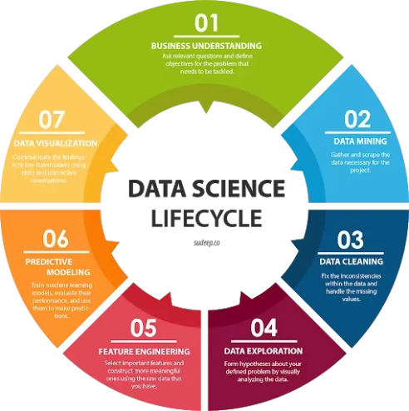
Data Science
Data Science is the process of extracting knowledge and insights from structured and unstructured data using statistical, machine learning, and analytical techniques.
Notes:
1

Slide 3


Data Science in the Music Industry
Explore how data science helps musicians create hit songs by understanding user preferences, predicting trends, and personalizing content.
Notes:
2

Slide 4
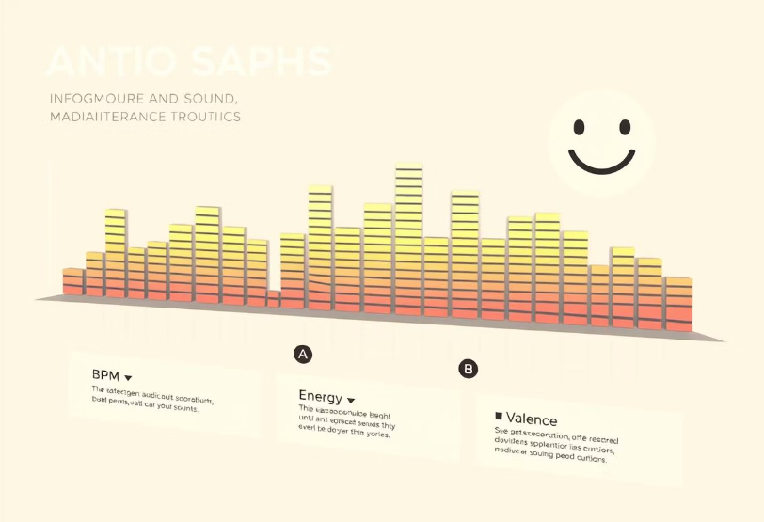
Can Data Help Make a Hit Song?
Objective
Identify audio characteristics contributing to a track’s success.
Analysis
BPM works best
Song energy and danceability
Genre, duration, and mood
An aspiring musician wants a Billboard charts hit song.
Notes:
3

Slide 5
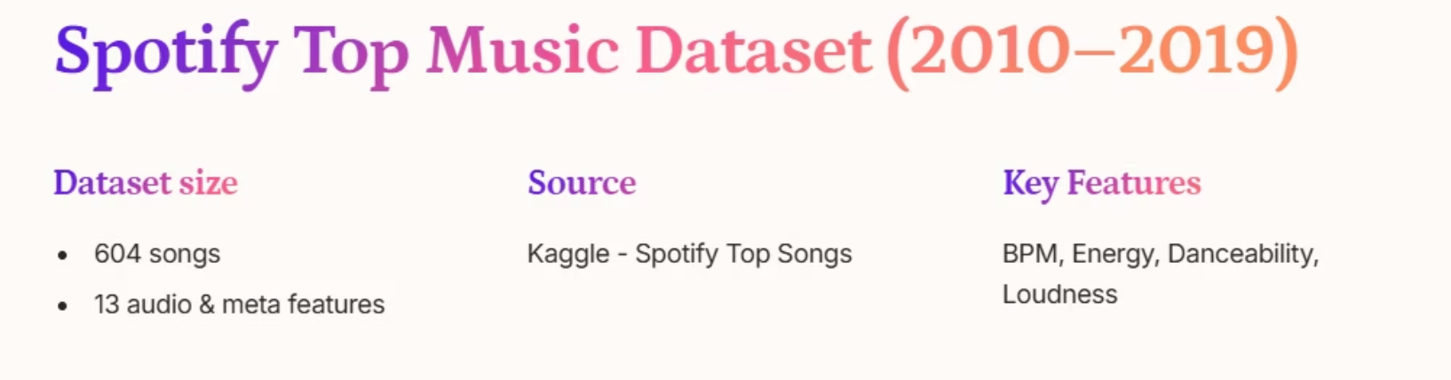
Notes:
4

Slide 6
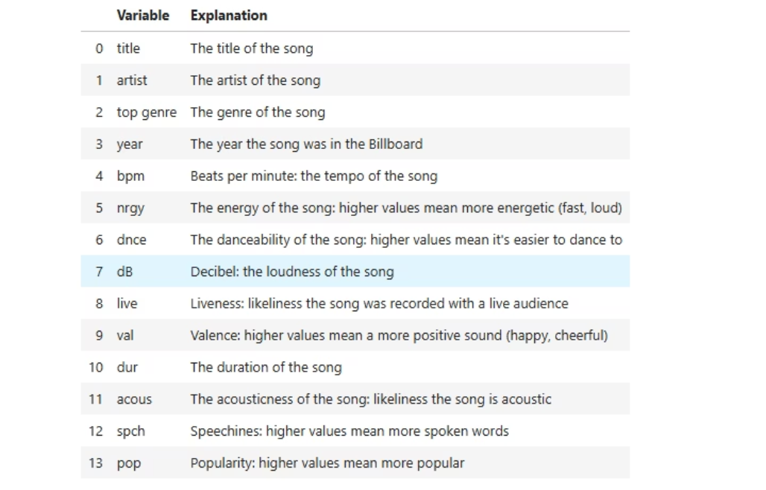
Data Dictionary
Notes:
5

Slide 7

Power of Data in Music
Data-Driven Music: Bridging Art and Analytics
Big Data
KNN Model
Predict market-ready traits.
Reinforces genre accuracy.
Pop Music
Upbeat, energetic vibes.
Data Science helps bridge creativity and strategy in music.
Notes:
6

Slide 8

Traits of a Hit Song
Characteristic
Recommended Value
BPM
118
Energy
70
Danceability
64
Genre
Pop
Data suggests the ideal structure for composing a successful track.
Notes:
7

Slide 9
Conclusion
​Based on Spotify's official Wrapped 2022 report, Pop was the most popular genre globally. This is evidenced by the top-streamed songs and artists of the year, such as "As It Was" by Harry Styles and artists like Taylor Swift and BTS, all of whom are prominent figures in the pop genre
Notes:
5

Slide 10
Refrences
[1] Barton, D. and Court, D. (2012), “Making Advanced Analytics Work For You”, Harvard Business Review, Vol. 90 No. 10, pp. 78-84.
[2] Salehan, M. and Kim, D. J. (2016). “Predicting the performance of online consumer reviews: A sentiment mining approach to big data analytics”, Decision Support Systems, Vol. 81, pp. 30- 40.
[3] DAVENPORT, T. H. 2014. Big data at work: dispelling the myths, uncovering the opportunities, Boston, Harvard Business Review Press. [4] D. Kiron, R. Shockley, N. Kruschwitz, G. Finch, and M. Haydock. Analytics: The widening divide. MIT Sloan Management Review, 53(3):1–22, 2011.
[5] Rogers and D. Sexton. Marketing roi in the era of big data: The 2012 brite and nyama marketing in transition study. Technical report, Columbia Business School, http://www.iab.net/media/file/2012-BRITE-NYAMA-Marketing-ROI-Study.pdf, 2012.
[6] Monetate. Connecting data to action. Technical report, Monetate, 2014b.
[7] Allen, F. F. Reichheld, B. Hamilton, and R. Markey. Closing the delivery gap. Technical report, Bain and Company, 2005.
Notes:
5

Slide 11
THANK YOU
Notes:
5

